Slide 1
DDS Analytics Analysis: Predicting Attrition and Monthly Income For EMPLOYEES AT Frito Lay

Slide 2
Introduction
Definition of Attrition
DATA OVERVIEW
Exploratory Data Analysis for Attrition and monthly income
Model building for prediction: attrition and monthly income
conclusion

Slide 3
Data overview
The data used is existing employee data of Frito lay that consists of 37 variables and 870 observations.

Slide 4
Prevention of turnover or attrition?
Turnover says more about the company than the employee.
Turnover is when an employee leaves due to termination, lack of opportunities for growth, or a better job.
Attrition is when an employee leaves for personal reasons such as to raise a family, go to school or due to retirement or death.
DDS Analytics wants to use existing employee data to predict employee turnover for prevention and monthly income.

Slide 5
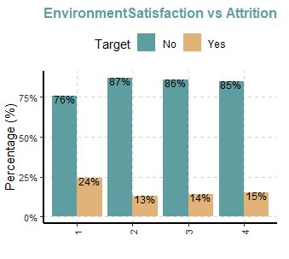
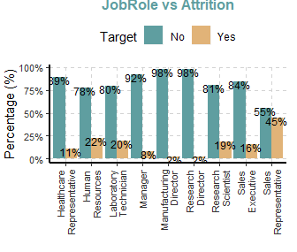
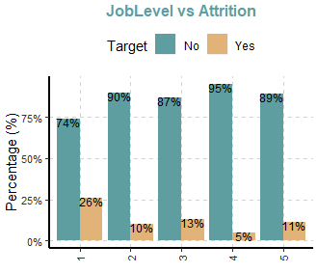
Exploratory data analysis:attriton
Employees with job roles Human Resources and Sales Representative have a higher attrition occurence
Employees with lower job levels have a higher attrition occurrence
The lower the environment satisfaction, the higher the attrition occurrence

Slide 6
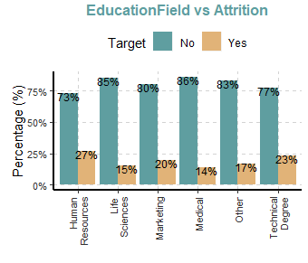
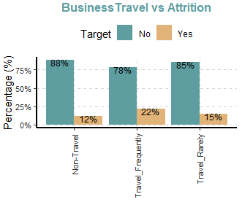
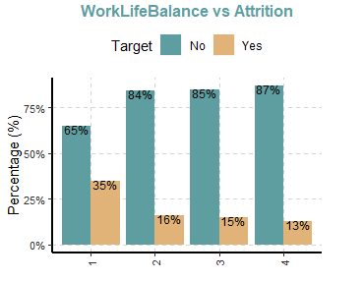
Exploratory data analysis:attriton
Employees that have education fields in Human Resources and Technical Degrees have higher attrition occurrence
Employees who travel frequently for business have a higher attrition occurrence
Employees who are dissatisfied (low) work/life balance have a higher attrition occurrence.

Slide 7
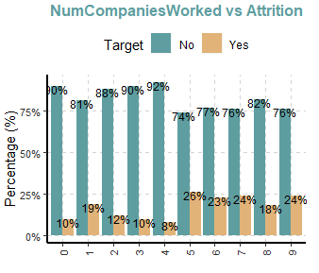
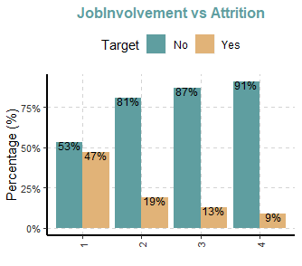
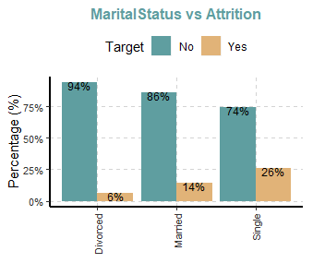
Exploratory data analysis: attrition
Employees who have worked for more companies have a higher attrition occurrence.
Employees with low job involvement have a higher attrition occurrence.
Single employees have a higher attrition occurrence.

Slide 8
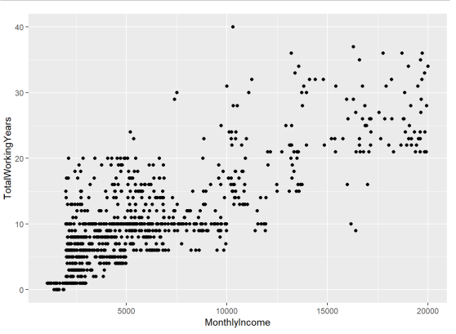
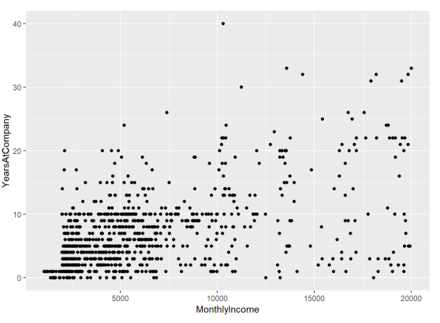
Exploratory data analysis: monthly income
Positive correlation between monthly income and number of years they have worked for the company
Positive correlation between monthly income and total number of working years

Slide 9
Building predictive models: attrition
Models used: logistic regression, naïve bayes, and random forest
With logistic regression Forward and stepwise selection was used:
Regression Predictive Model | AIC
Forward | 363.51
stepwise | 342.64
Using the roc function the stepwise model has an accuracy of 80%.

Slide 10
Building predictive models: monthly income
Linear regression model: stepwise regression model performs the best
Predictive Regression Model | AIC | Adj R-sq | RMSE
Forward | 8518.132 | 0.9463 | 1100.821
Stepwise | 8478.958 | 0.9476 | 1091.922

Slide 11
conclusion
Out of all three, the logistic regression model performed the best with an accuracy of 80%, sensitivity of 84% and specificity of 62%.
For predicting monthly income the step wise linear regression prediction model performed the best with the lowest RMSE and AIC.
Being able to find the factors that contribute to attrition, allow the talent management to implement programs such as employee training programs, to identify high-potential employees and reducing/preventing voluntary employee turnover (attrition).

Slide 12
Q&A
THANK YOU

